Slide 1
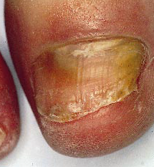

Slide 2
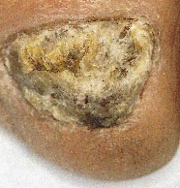

Slide 3
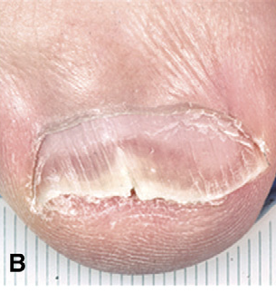

Slide 4
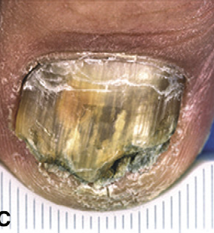

Slide 5
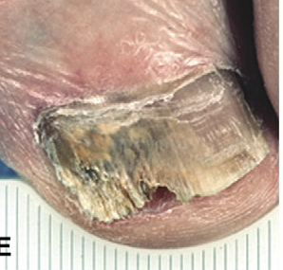

Slide 6
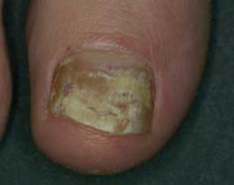

Slide 7
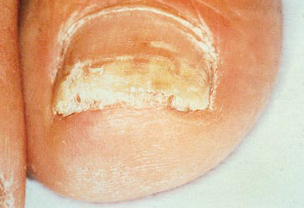

Slide 8


Slide 9
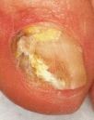

Slide 10
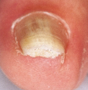

Slide 11
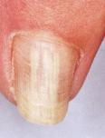

Slide 12
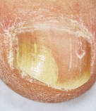

Slide 13
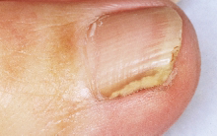

Slide 14
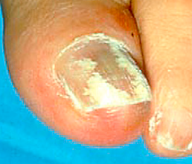

Slide 15
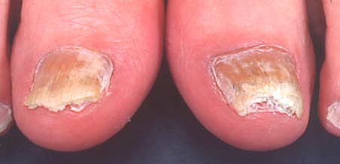

Slide 16
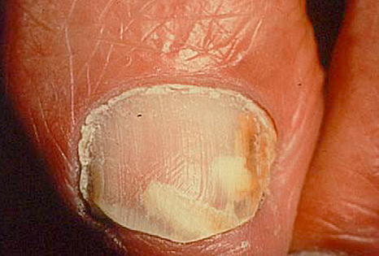

Slide 18
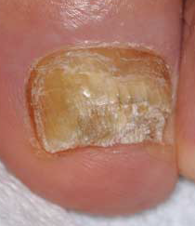

Slide 19
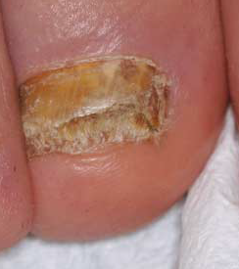

Slide 20
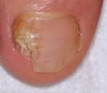

Slide 21
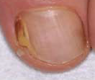

Slide 22
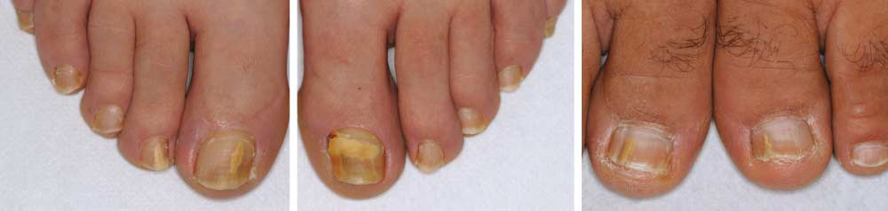
Examples of dermatophytoma. A, Yellow patch. Note that the borders of the patch are not contiguous with the distal edge. B, Large yellow patch.
C, Yellow streaks

Slide 23
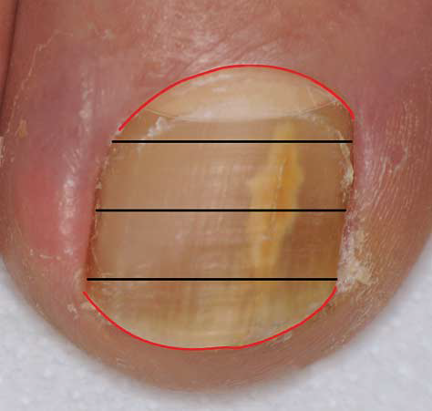
Notes:
Figure 1. Proximity to matrix scoring. The nail is divided transversely into
quarters. Involvement of the distal quarter is given a score of 1 (distal groove
in red); if involvement extends to the first half of the nail, it is given a score
of 2; the third quarter, a score of 3; and the proximal quarter, a score of 4.
Involvement of the lunula (outlined in aqua) and the proximal nail fold (red)
represents matrix involvement and is given a score of 5.

Slide 24
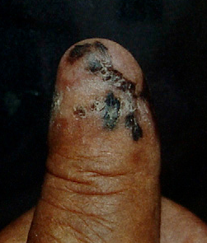
Fig 10. Hutchinson sign in patient with melanoma of
thumb.
Notes:
Fig 10. Hutchinson sign in patient with melanoma of
thumb.

Slide 25
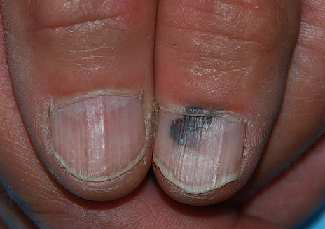
Notes:
11. Pseudo-Hutchinson sign in patient with subungual
hematoma.

Slide 26
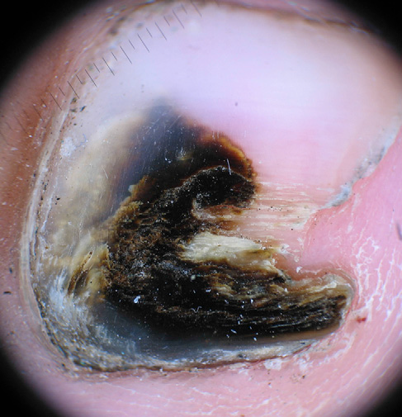
Notes:
Fig 9. Dermatoscopy of Aspergillus infection, showing
homogenous black pigment.

